Slide 1



Slide 2


Slide 3


Slide 4


Slide 5


Slide 6


Slide 7


Slide 8
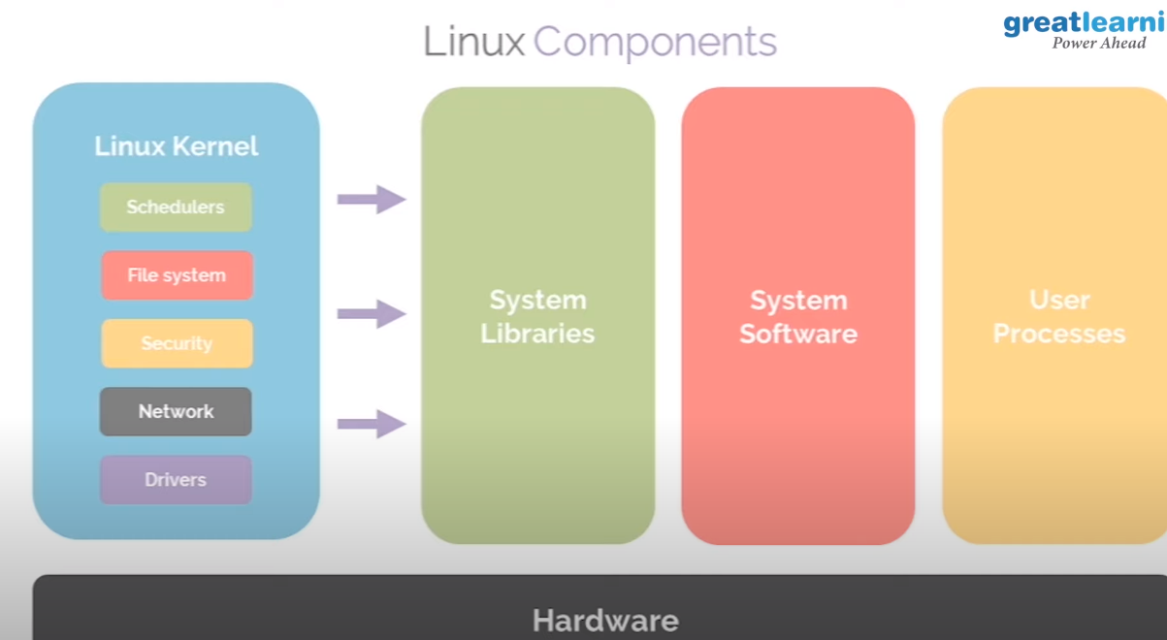

Slide 9
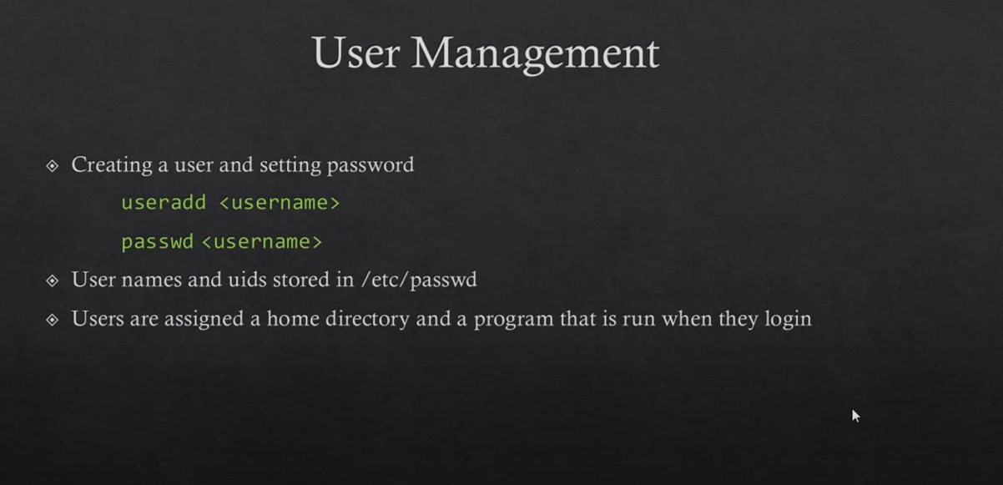

Slide 10
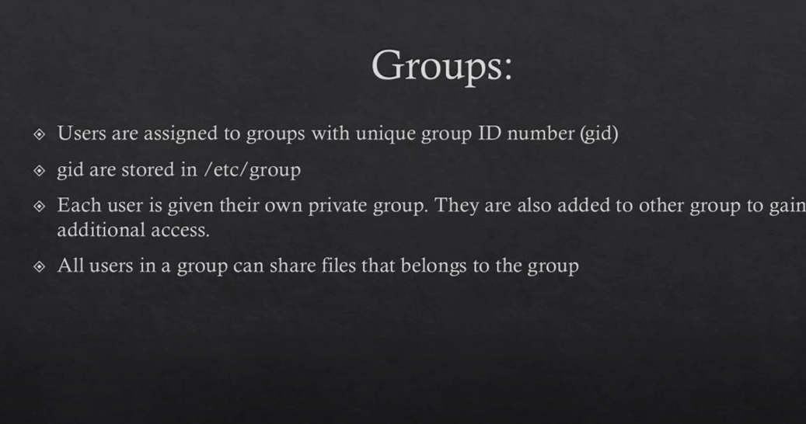

Slide 11
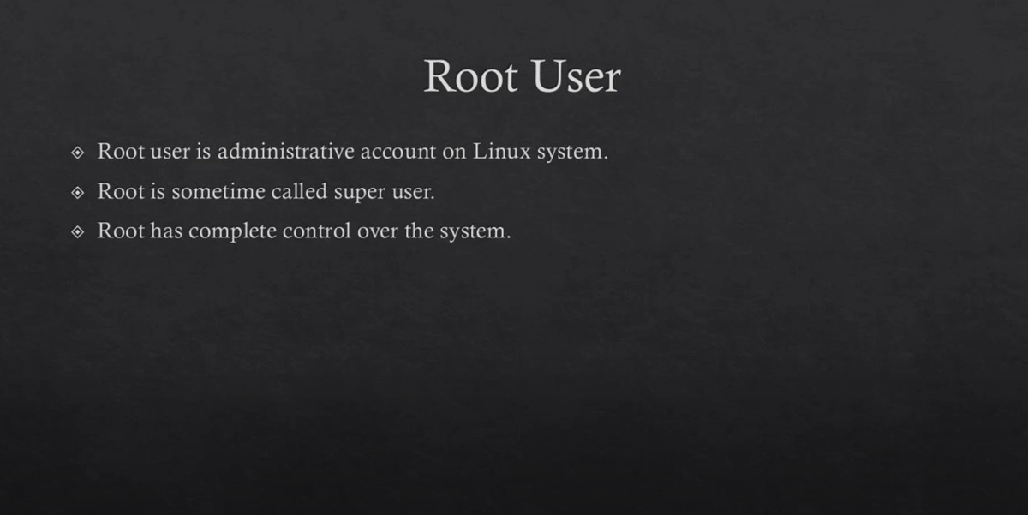

Slide 12
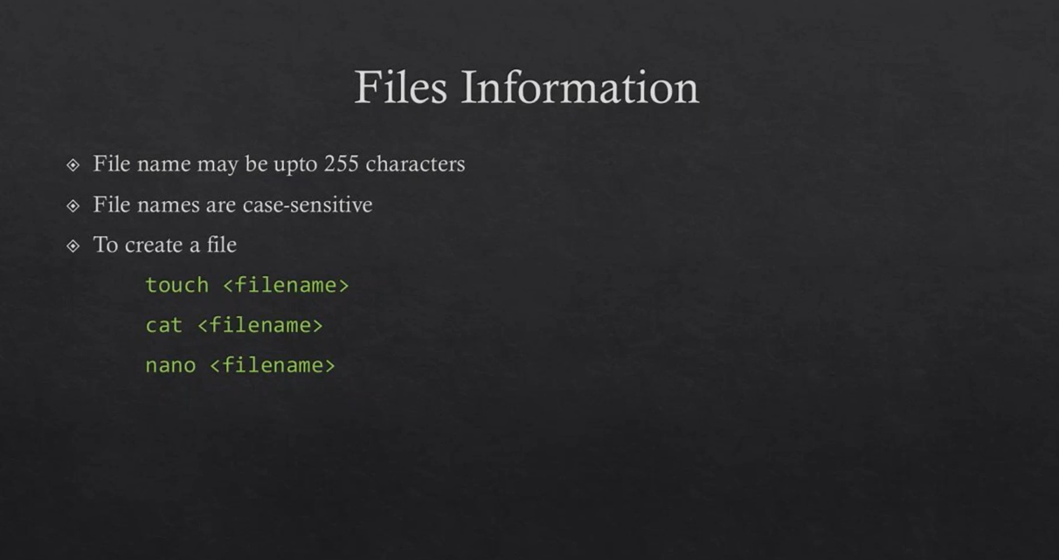

Slide 13
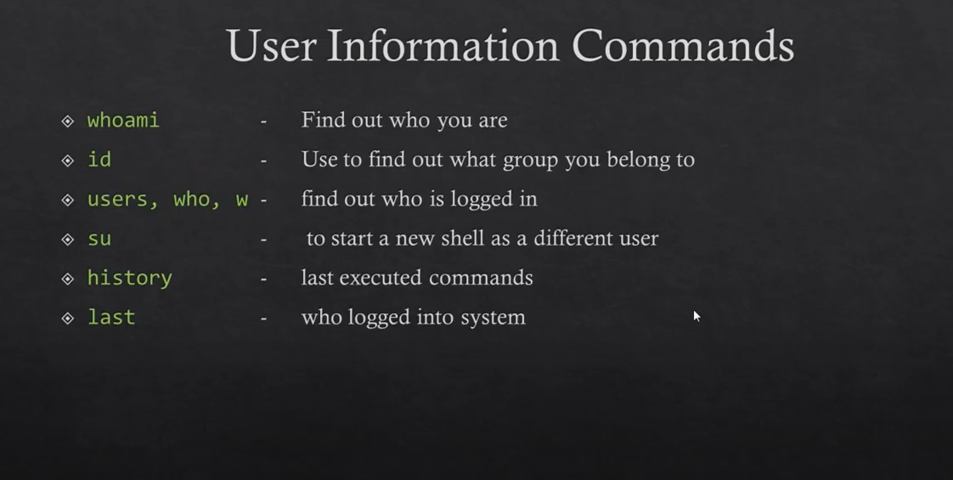

Slide 14
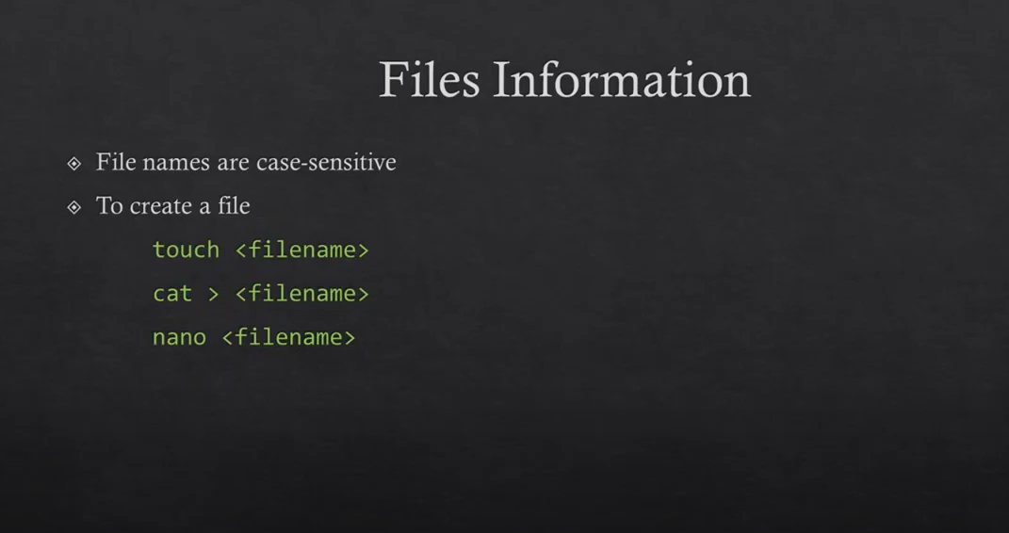

Slide 15
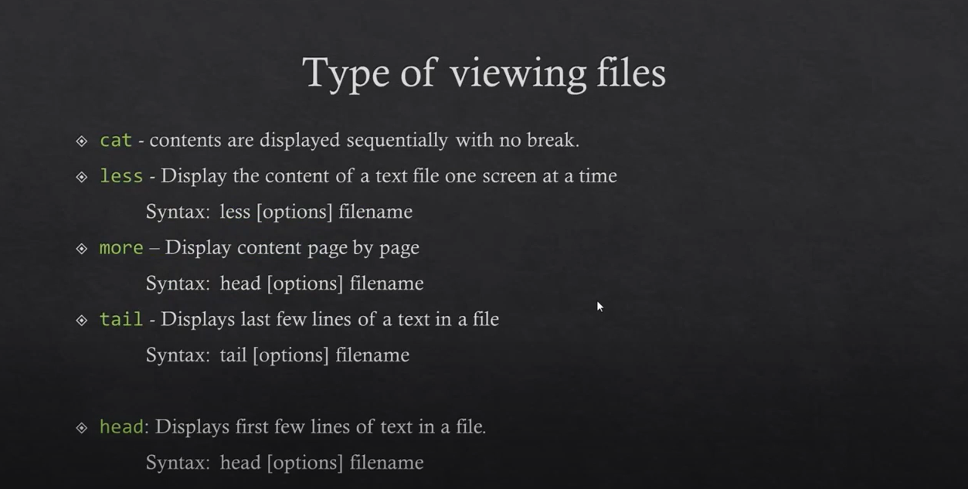

Slide 16
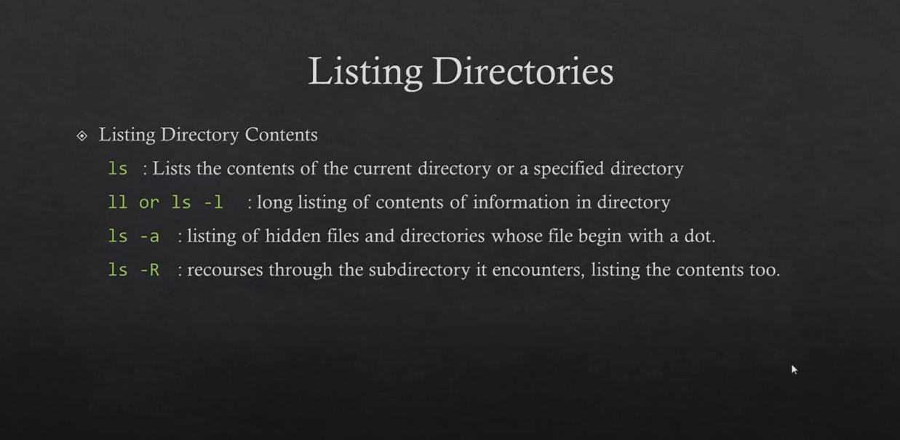

Slide 17
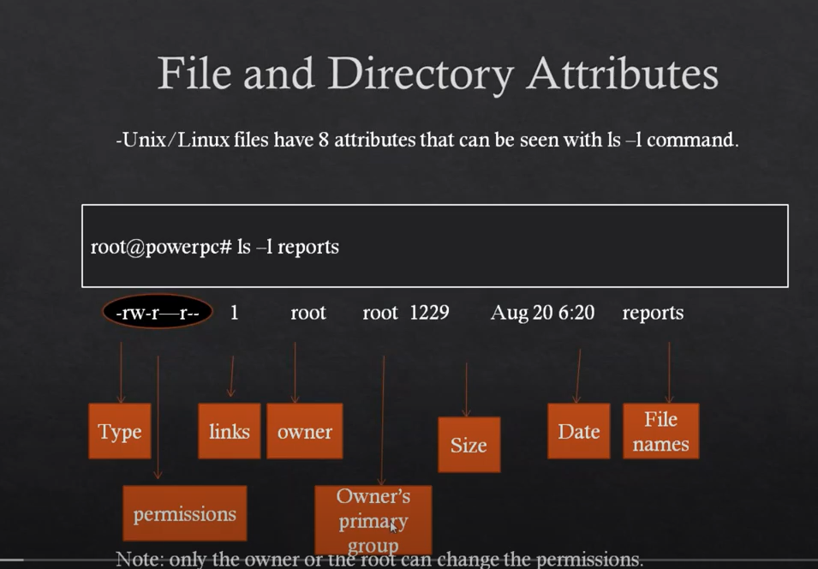

Slide 18


Slide 19
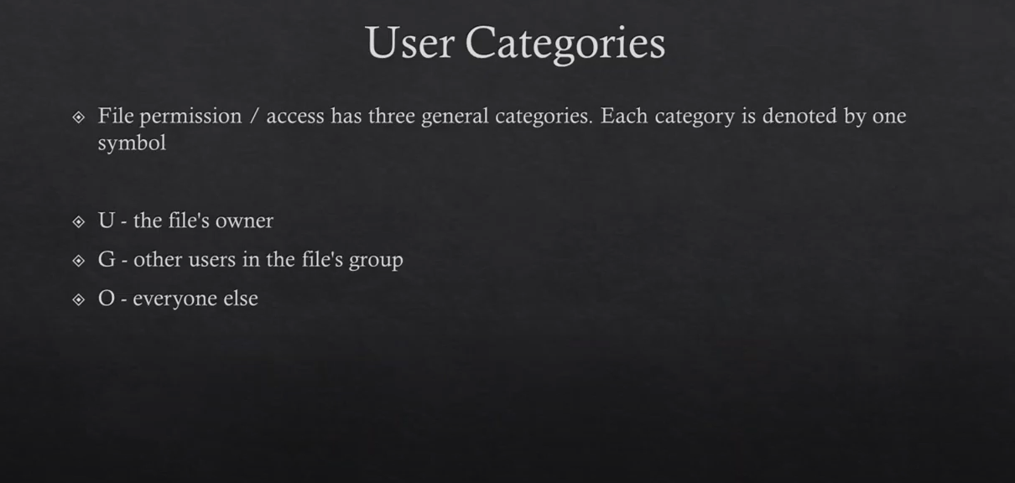

Slide 20
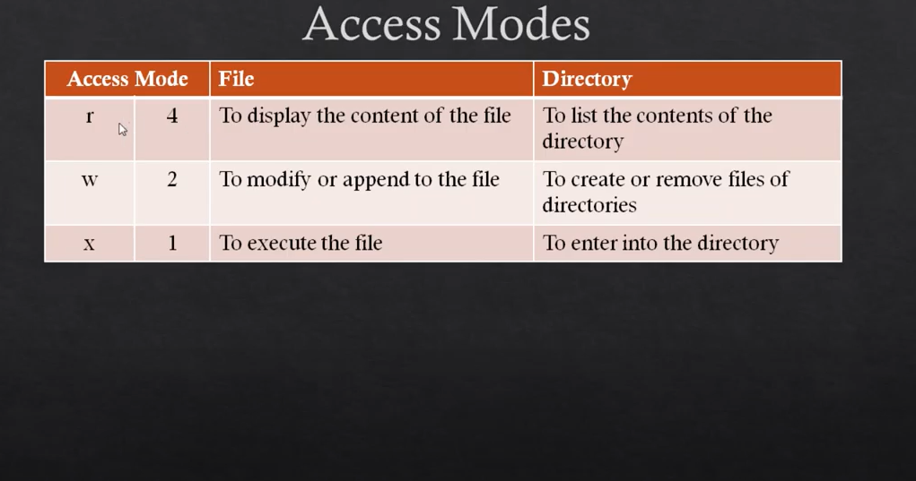

Slide 21
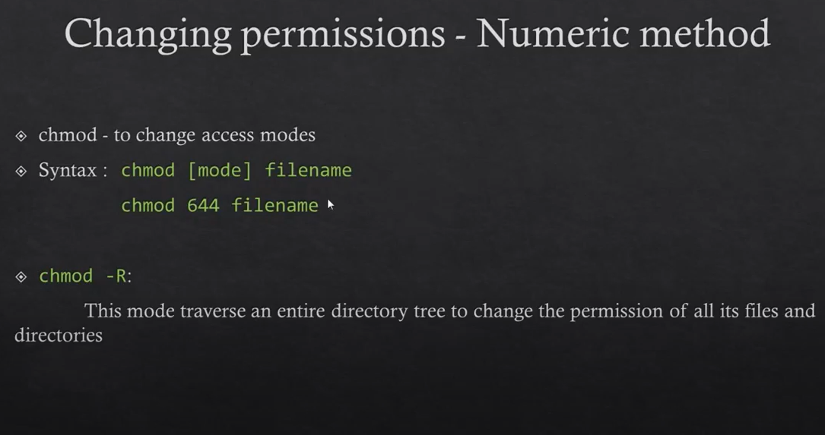

Slide 22
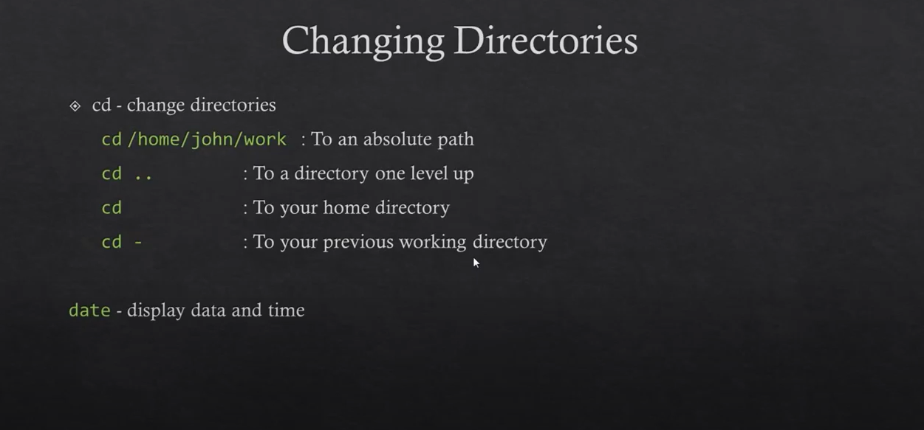

Slide 23
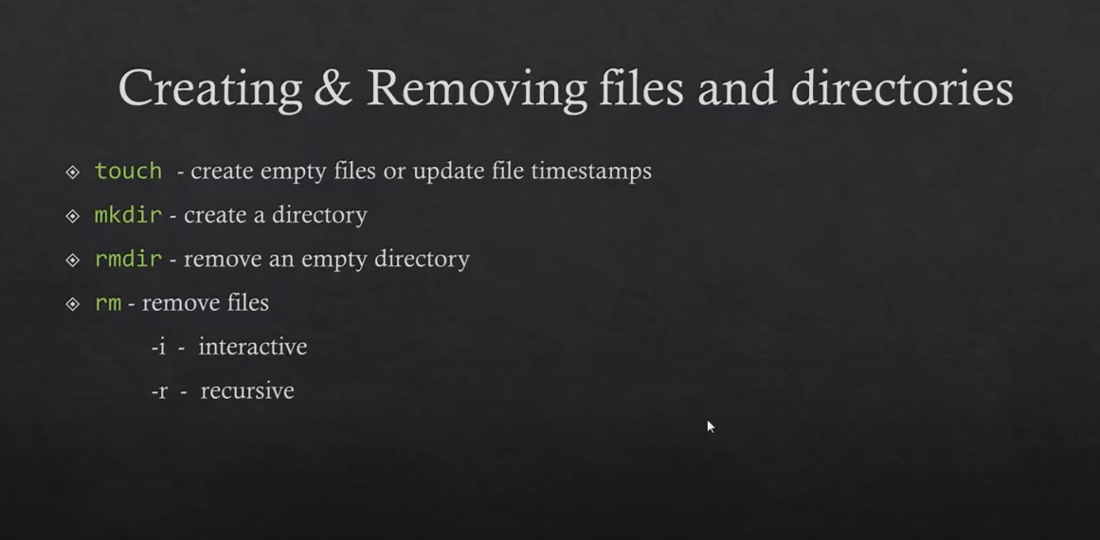

Slide 24
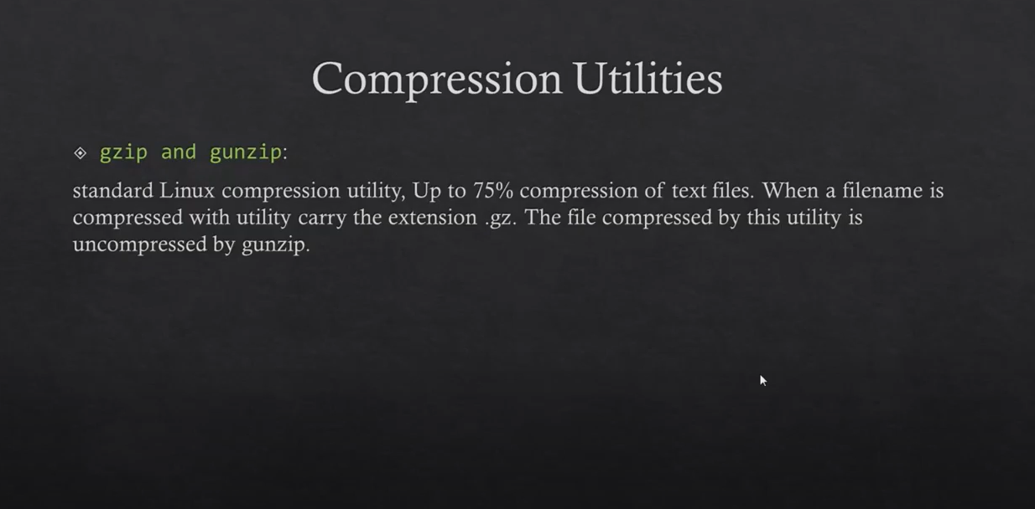

Slide 25
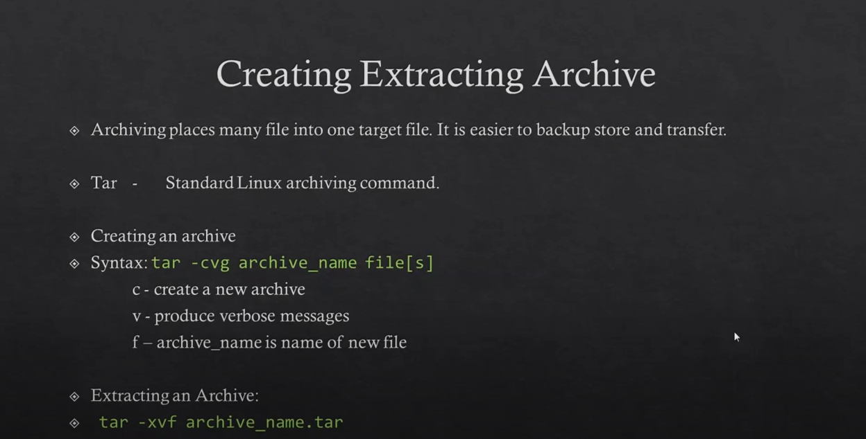

Slide 26
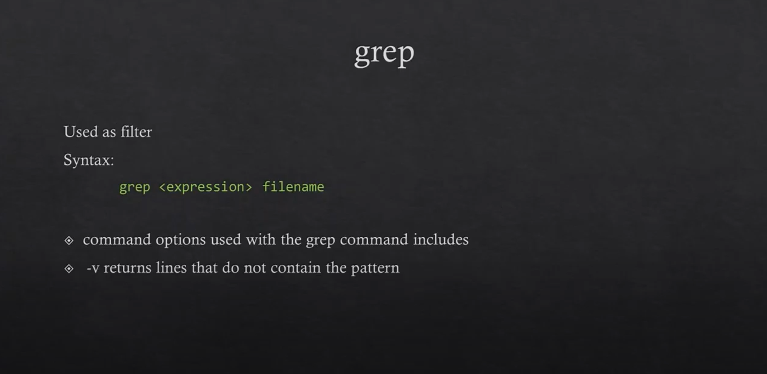

Slide 27
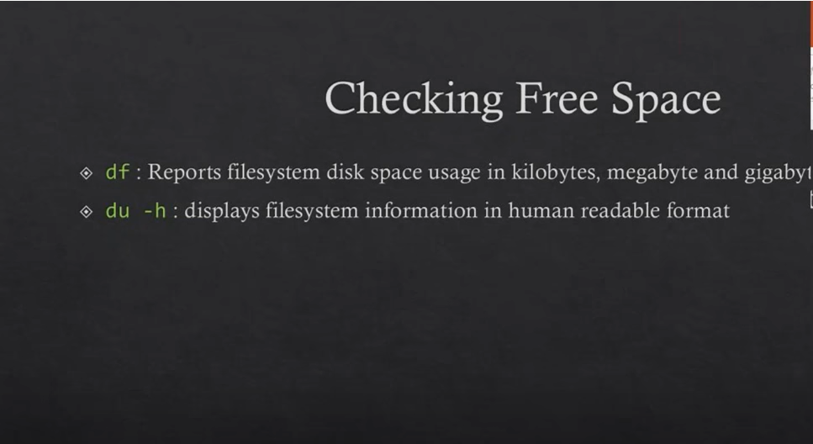

Slide 28
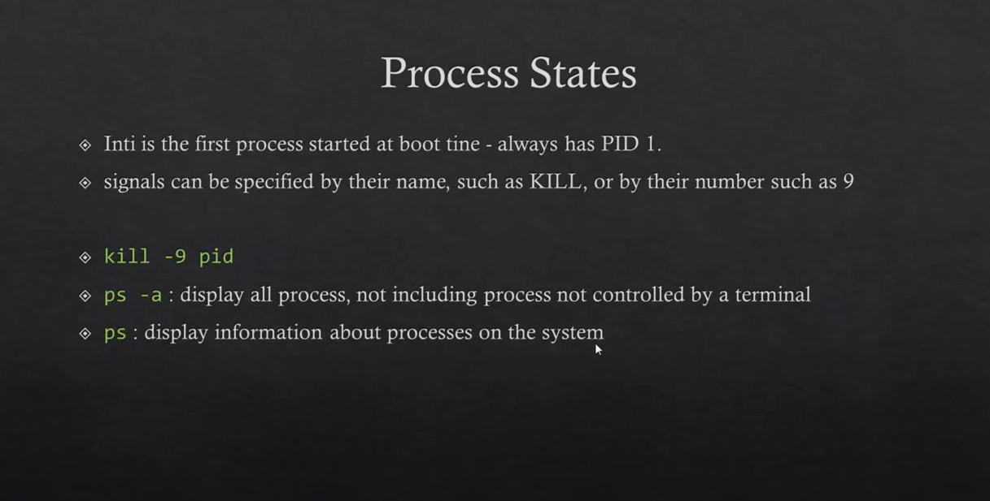

Slide 29
Service Operation
$ sudo systemctl <verb> <service-name>
<verb> : Any of following actions to perform on a Service
status : Display the status of a service
stop : Stops a Service
start : Starts a Service
restart : Restarts a Service
<service-name> : Name of a service
Example:
$ sudo systemctl status systemd-networkd
● systemd-networkd.service - Network Configuration
Loaded: loaded (/lib/systemd/system/systemd-networkd.service; enabled; vendor >
Active: active (running) since Tue 2024-04-02 23:53:59 UTC; 4h 55min ago
TriggeredBy: ● systemd-networkd.socket
Example:
$ sudo systemctl stop systemd-networkd
$ sudo systemctl start systemd-networkd
$ sudo systemctl restart systemd-networkd

Slide 30
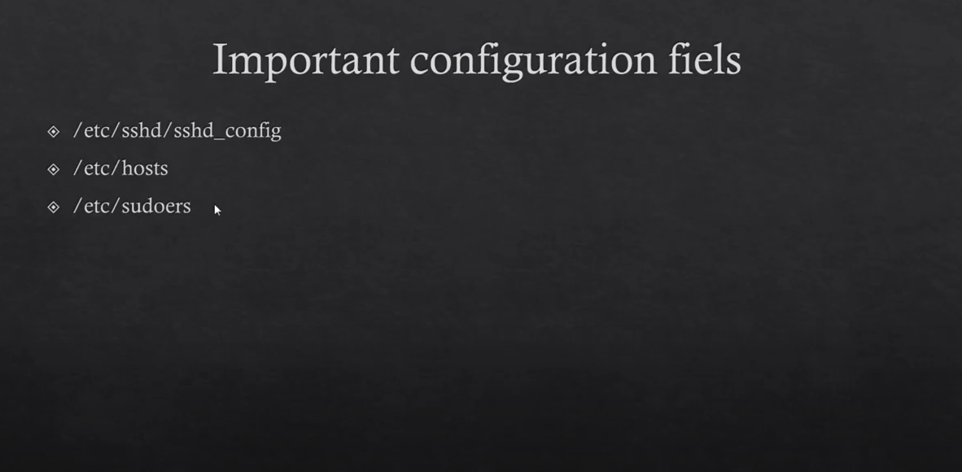

Slide 31
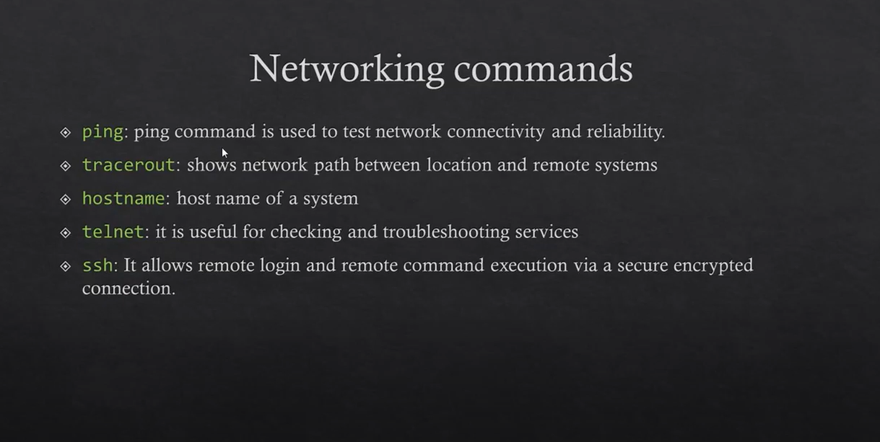

Slide 32
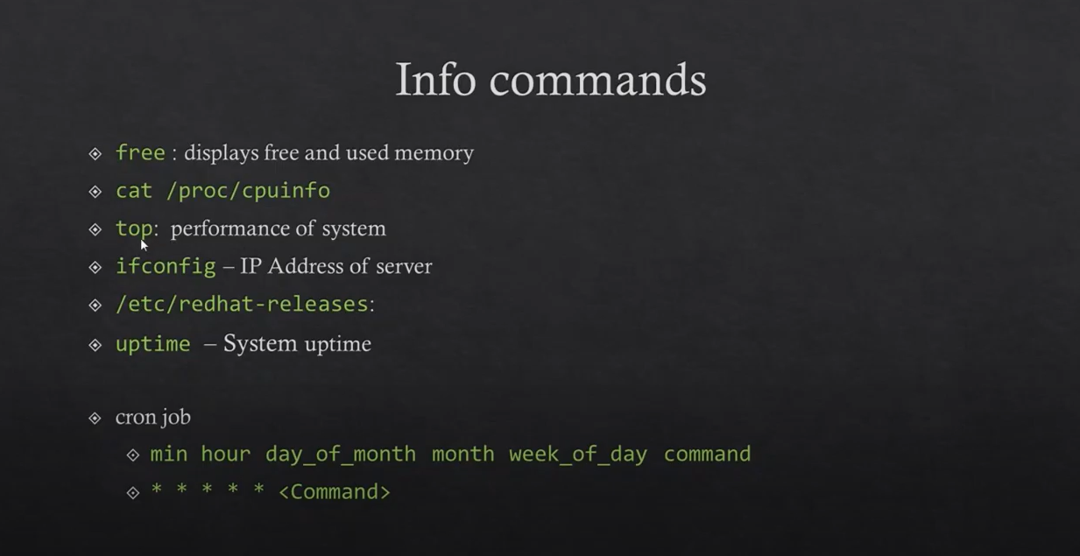
/etc/os-release – Check OS version

Slide 33
Package Operation
$ sudo apt install <package-name>
Example:
$ sudo apt install git
$ sudo apt remove <package-name>
Example:
$ sudo apt remove git

Slide 34
Thank You

